Slide 1
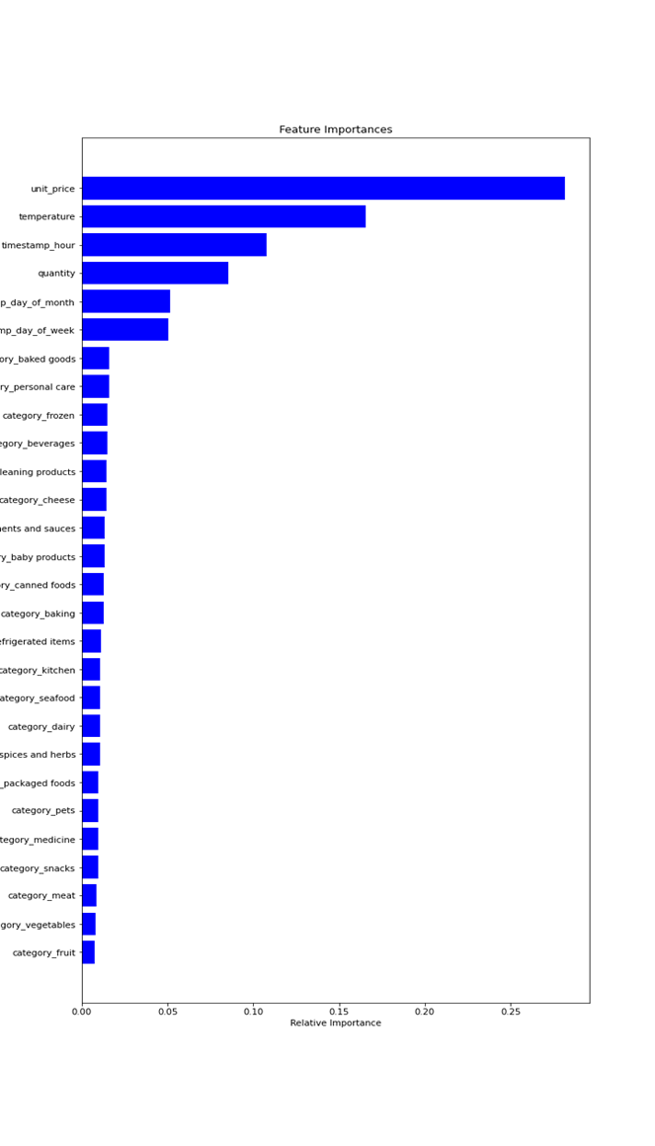
Data sets provided by the client. Here we incorporated data loading, data exploration, data cleaning and data merging.
The data sets provided were in timestamp basis and we transformed into hourly basis and it is the requirement by the client.
Apparently we need more set of data to test the model for production so we need more samples.
To transform the columns of the data, here we used feature engineering and k-fold method validation on random samples of data.
In this data we leaved 30% of sample data for testing.
For Modelling we used Random forest regressor to predict the binary outcome. And their results were interpretable.
To train the model we created a loop where 75/25% random split of data between training and testing the samples.
Temperature was also significant within the model, with more IoT data across a larger time period, we believe the accuracy of this model will increase.

